Slide 1
IXP Regulation in Central Asia
16 November 2022
Central Asia Peering and Interconnection Forum #1
Kevin Meynell
Senior Manager, Technical & Operational Engagement
meynell@isoc.org

Slide 2
Introduction
November 2021 study performed by Cullen International in collaboration with the Internet Society
Investigated the legal and regulatory situation for IXPs and their networks in Central Asia
Five countries were studied:
Kazakhstan
Kyrgyzstan
Tajikistan
Turkmenistan
Uzbekistan

Slide 3
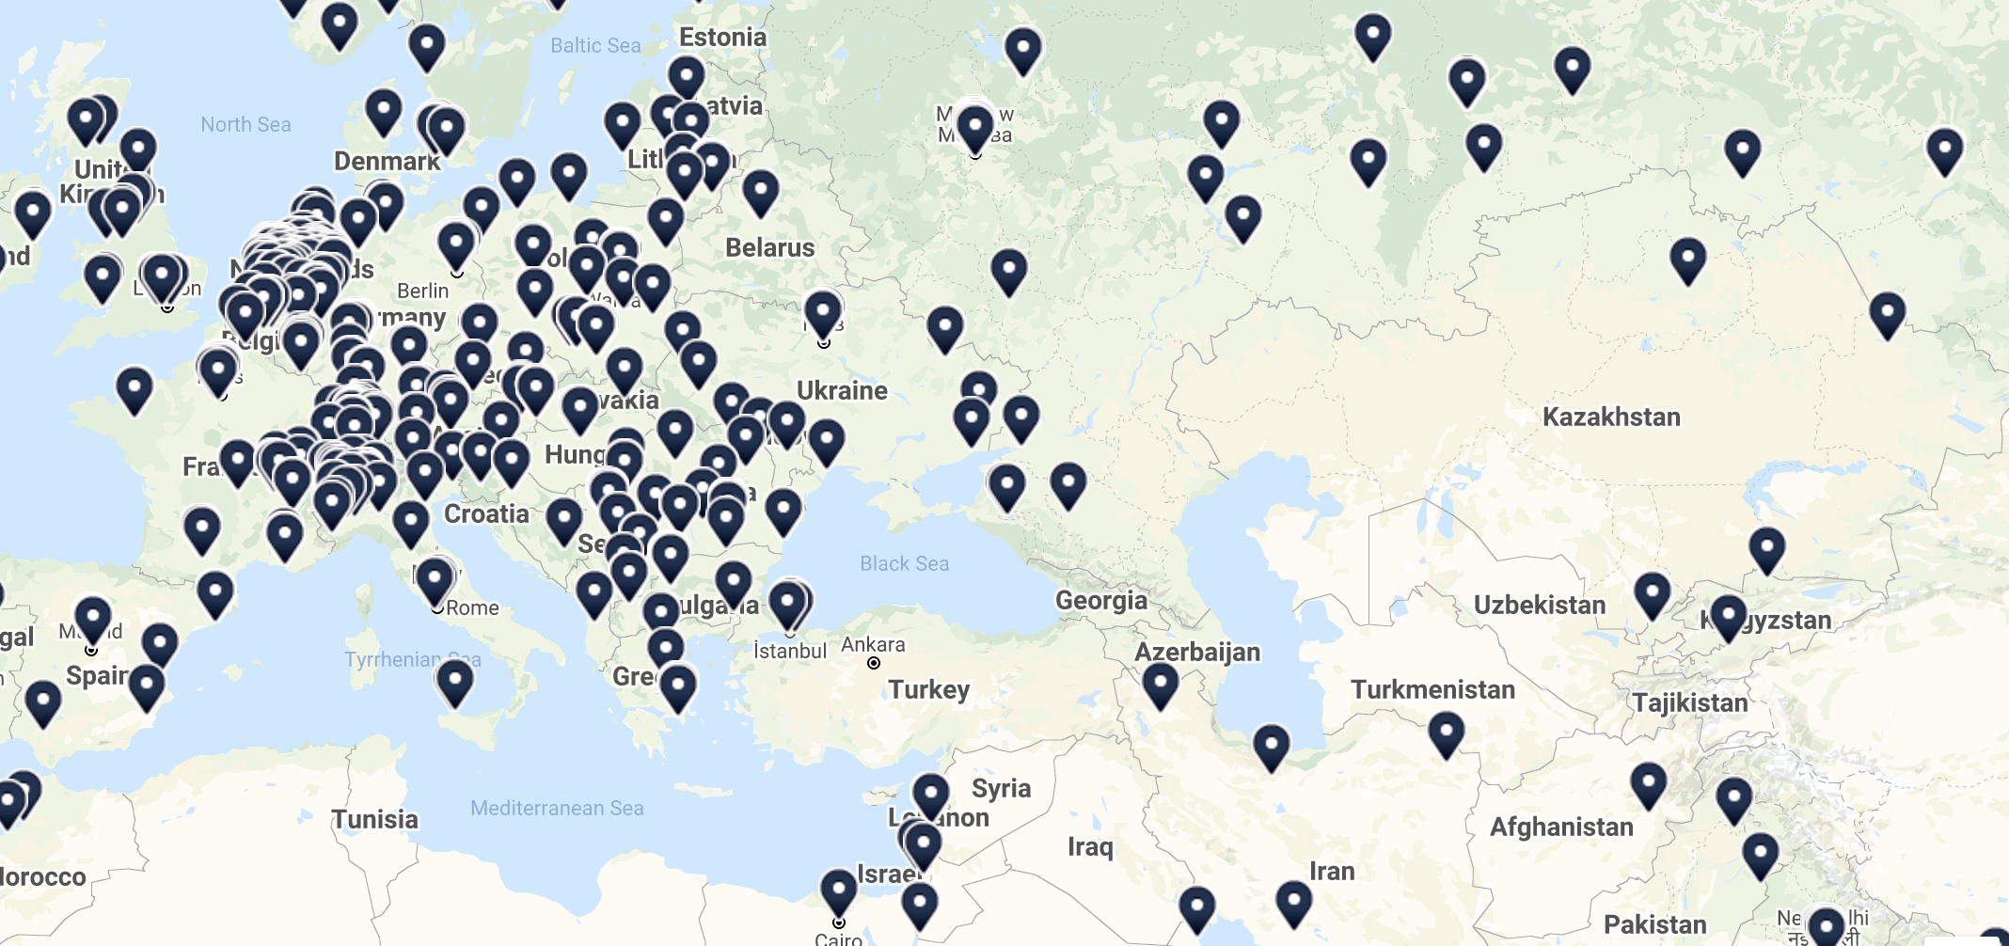
IXP Map (courtesy of Euro-IX)

Slide 4
Laws or Regulations specifically for IXPs
Kazakhstan – Yes, IXP provision is a state monopoly defined by Telecommunications Law of 2004. Connections to IXPs are controlled by Government Technical Services (GTS) Law of 2015.
Kyrgyzstan – No specific laws, other than requirement to obtain licence.
Tajikistan – No specific laws.
Turkmenistan – IXPs are regulated by laws “On the legal regulation of the development of internet and the provision of internet services in Turkmenistan” (last amended 2017) and “On communications” (2010 last amended 2021).
Uzbekistan – No specific laws. IXPs operate under laws “On telecommunications” (1999 last amended 2021), and “On communications” (1992 last amended in 2017)
Western European countries - no licences or requirements to start an IXP.

Slide 5
Requirements for establishing an IXP
Kazakhstan - it’s a state monopoly
Kyrgyzstan - requires two licenses: one from the Ministry of Justice & the second from the State Communications Agency, and founders are background checked. The application fee is low and an answer takes up to 30 days. Operating IXPs must provide statistical reports to government.
Tajikistan - requires IXPs to have a data transmission license and register to pay taxes.
Turkmenistan - some licensing is required in Turkmenistan and specific details are still being researched.
Uzbekistan - requires IXPs to get an ISP license and all equipment purchases must meet certification requirements.
Western European countries - no licences or requirements to start an IXP.

Slide 6
Legal requirements for interconnecting networks
Kazakhstan - networks must interconnect through the Government Technical Services (GTS).
Kyrgyzstan - no special laws but there is a regulation about interconnection with mobile cellular data providers which is being researched.
Tajikistan - Almost all telecom operators are peered with each other and agreements are registered with the government communications service. There are open questions on what they mean by peering and whether peering is settlement free.
Turkmenistan - We believe rules are defined by the regulator and approved by the responsible ministry but specific details regarding the full scope of interconnection regulation are unclear.
Uzbekistan - requires networks to submit peering requests to the State Cyber Security office but details on whether this is a registration or an approval are not clear.

Slide 7
What kinds of network may interconnect?
Kazakhstan - no restrictions.
Kyrgyzstan - allows licensed networks to interconnect.
Tajikistan - Large networks already have connections to CDNs, smaller networks connect to them via the larger networks.
Turkmenistan - no information available.
Uzbekistan – no restrictions.
Western European countries – no restrictions.

Slide 8
Are there any security laws applicable to IXPs?
Kazakhstan - no specific laws, except monitoring implemented by GTS
Kyrgyzstan – no specific laws, except general operational search instructions (2014) by state bodies are applicable to telecommunication and mobile operators.
Tajikistan – peer-to-peer communications do not require security monitoring or content filtering.
Turkmenistan – Communications Law (2010 amended 2014) relating to development of Internet and provision of Internet services.
Uzbekistan – No content filtering regulations. Regulations that are applicable “On regulation of the network interoperability of internet providers on the data transmission networks” (2004 last amended in 2021) and “On organisation of the use of technical means of the system for operational- search activities on the telecommunication networks of the Republic of Uzbekistan” (2006).
Western European countries – no restrictions.

Slide 9
Conclusions
Central Asian countries apply different approaches to the regulation of IXPs and interconnection.
There are still gaps in our knowledge.
Even where information is available it does not always tell the whole story.
Additional research is needed and we welcome input.

Slide 10
Discussion

